Slide 1

DICOM Imaging Intro

Slide 2
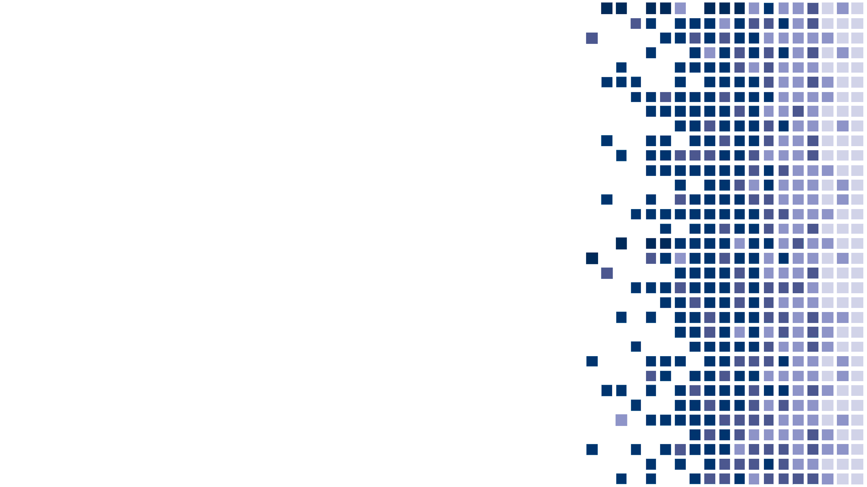
Bogdan Petrovan
Director of Product Engineering
Support repo: https://github.com/petrovanster/dicom_intro

Slide 3
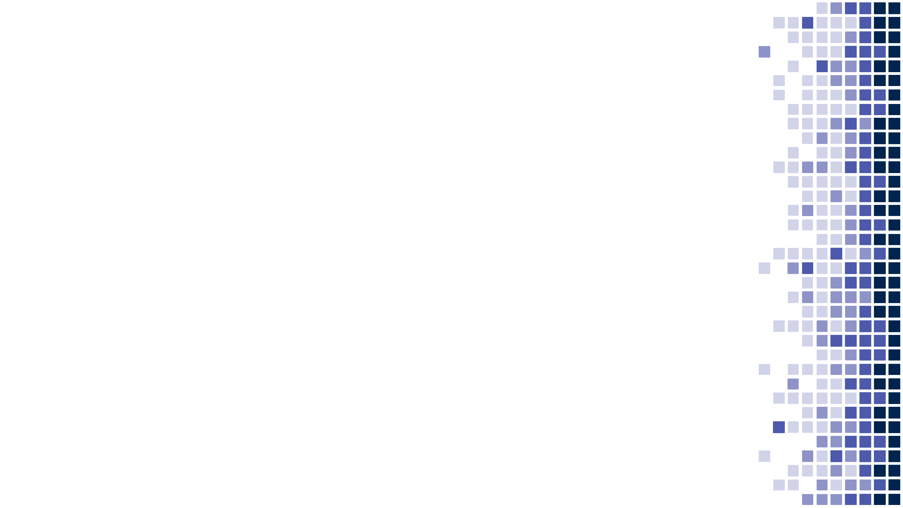
About Laitek Inc
The company's journey starts with Fred Behlen, Ph.D., a leading specialist in imaging informatics, who founded it back on the 8th of August 1980.
Originally named Laboratory Automation Inc., it later changed to Laitek Inc.
On the other side of the world, the Romanian company was founded by Razvan Costea-Barlutiu. Initially called Light Soft, it was renamed Laitek Medical Software in 2016.
What we do
We perform medical data migration services either directly for hospitals or as a subcontractor to replacement PACS vendors. We've also started selling our own software products, more information will follow in the next resource.

Slide 4
About Laitek Inc
Our Clients
With facilities in both Europe and the U.S., Laitek serves clients across the globe. Our Migratek® and Semperdata® solutions are specially designed for large hospital networks, delivered both directly and through OEMs.
Here are some of our recurring customers, those who saw the value of the work we bring to their environment and keep coming back, asking for our thought leadership and expertise:
Mayo Clinic
John's Hopkins
Stanford
University of Pennsylvania
Hospital Corporation of America
Unity Point

Slide 5
About Laitek Inc
Offices
World Headquarters
2024 Hickory Road, Suite 208, Homewood, Illinois 60430, P: 708.799.5000
Romania
Republicii 87 & 81, Cluj-Napoca, 400489, P: +40 364 802 630
United Kingdom
10 John Street, London, WC1N 2EB, P: +44 (0) 203 6081276
Visit us http://www.laitek.com/ | Follow us on Facebook https://www.facebook.com/laitekinc https://www.facebook.com/LaitekRomania Follow us on LinkedIn https://www.linkedin.com/company/laitek/

Slide 6
About Laitek 4-5 slide-uri

Slide 7
Overview
About DICOM
DICOM Services
Informational Model

Slide 8
What is DICOM?
Digital Imaging and Communications in Medicine - specifies a non-proprietary data interchange protocol, digital image format, and file structure for biomedical images and image-related information.
First version in 1993, continuing ACR/NEMA 2.0
Areas of usage
Encode the data produced by a wide variety of imaging device types, including, CT (computed tomography), MRI (magnetic resonance imaging), ultrasound, X-ray, fluoroscopy, angiography, mammography, breast tomosynthesis, PET (positron emission tomography), SPECT (single-photon emission computed tomography), Endoscopy, microscopy, OCT (optical coherence tomography).
Fields of medicine: radiology, cardiology, oncology, nuclear medicine, radiotherapy, neurology, orthopedics, obstetrics, gynecology, ophthalmology, dentistry, maxillofacial surgery, dermatology, pathology, clinical trials, veterinary medicine, and medical/clinical photography.
Industries: healthcare, veterinary, customs, petrol

Slide 9
DICOM Services
Service definition
Semantic – what each service has been designed for
Protocol – what kind of information is exchanged and how is presented
Application Entities (AE) – nodes providing/using DICOM services
A system might be comprised of one or more AEs
Service Class Provider (SCP) – node providing the service. Eg:
Object storage (aka C-Store)
Verification (aka C-Echo)
Print
Query/Retrieve
Service Class User (SCU) – node using the service
Service Object Pair (SOP) Class – combination of command and an Information Object Definition (IOD)
SOP Instance – an instance of a Class, eg Computed Radiography Image Storage
Notes:
.

Slide 10
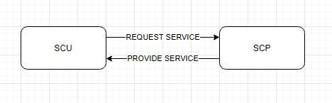
Associations
Simple:
The SCU will start the communication and will ask the SCP if it supports a certain service.
The SCP will respond accordingly.
The SCU will ask something related to that service (ex: do a cfind or store an image)
The SCP will provide the negotiated services (respond, store images)
The SCU when done can drop the association or ask an association release
The SCP will acknowledge the association release
(the initial service request and how that service will be managed by the two participants during communications is the actual association negotiation)
Notes:
The physician places one or more orders for these x-ray procedures with the RIS. When an order is entered, a order message is triggered and sent from the RIS to the Modality Worklist, which keeps a list of all of the patients who are to receive a radiological exam of one kind or another. A modality refers to the kind of device which performs the radiological examination, such as a CT machine, an MRI machine, an ultrasound machine, and so on). The order contains details about when the exam is scheduled, what type of imaging procedure is going to be performed, the location of the exam (which imaging room, which modality) etc.

Slide 11
DICOM Services
US_EM
(SCU)
Ultrasound station
EA_VNA
(SCP)
Enterprise Archive
Store Ultrasound Image
(service class: Ultrasound Image Storage)
List of SOP classes: B.5 Standard SOP Classes (nema.org)

Slide 12
Information Object
An Information Object Definition (IOD) is an object-oriented abstract data model used to specify information about Real-World Objects. An IOD provides communicating Application Entities with a common view of the information to be exchanged.
US_EM
(SCU)
Ultrasound station
EA_VNA
(SCU)
Enterprise Archive
Store Ultrasound Image
(class: Ultrasound Image Storage)

Slide 13
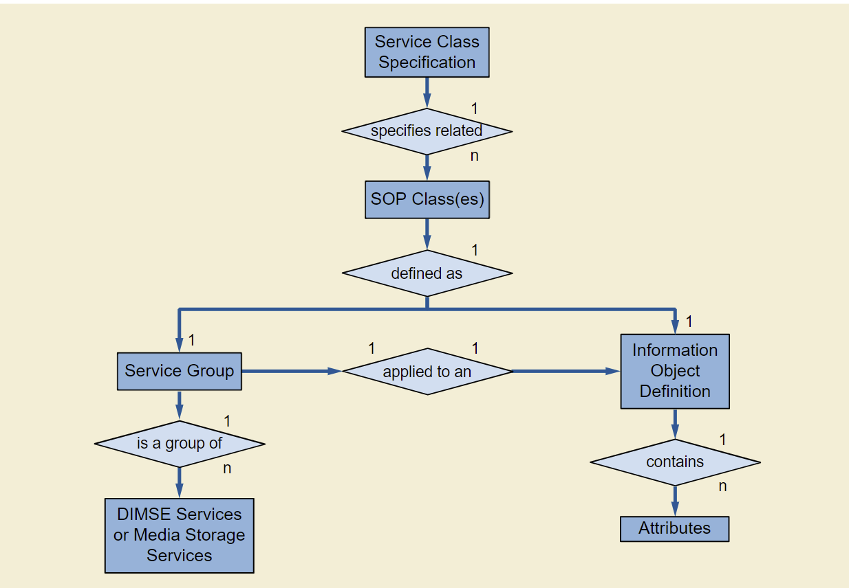
DICOM Services
Service Object Pair (SOP) Class – combination of command and an Information Object Definition (IOD)
SOP Instance – an instance of a Class, eg Computed Radiography Image Storage

Slide 14
Informational Objects
Informational Object Class – provides an abstract definition of real-world entities applicable to communication of digital medical images and related information (e.g., waveforms, structured reports, radiation therapy dose, etc.).
Two types:
Normalized: include only Attributes inherent in the real-world entity
Composite: include Attributes that are related to but not inherent in the real-world entity. Eg patient name in a CT image
Abstract Syntax – service class or IOD referenced when negotiating associations between Aes
Ref A.3.5 Basics of DICOM Communication (nema.org)

Slide 15
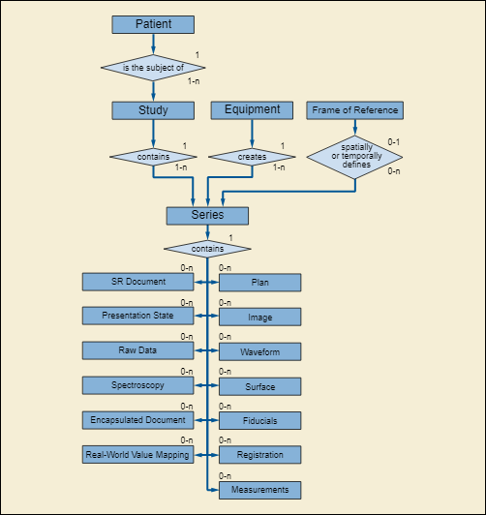
Composite IOD - modules

Slide 16
DICOM Attributes
Attributes – smallest unit of information in IODs
Definition - (group,element), VR, Value Length, Value
(Group,element) – semantic meaning of the attribute, coded as 4B, e.g. PatientName, StudyInstanceUID, SamplesPerPixel
VR – Value Representation, represented as 2B, eg: CS – Coded string, UL – unsigned long; 6.2 Value Representation (VR) (nema.org)
Value length 2B – Length in bytes of value (data)
Value – actual value of the attribute

Slide 17
Image Module - highlights
Samples per pixel = 1/3
Bits per sample = 8/16
High bit = 7,8 / 12,14,16
Photometric Interpretation = MONO1/2, RGB, YUV, YUV 422, YUV 420
Planar Configuration = 0,1 – jpeg compression over planar 1
According to the modality, there are specific attributes, eg https://dicom.nema.org/medical/dicom/current/output/chtml/part03/sect_C.8.11.7.html

Slide 18
Image attributes
Samples per pixel = 1/3
Bits per sample = 8/16
High bit = 7,8 / 12,14,16
Photometric Intepretation = MONO1.2, RGB, YUV, YUV 422, YUV 420
Planar Configuration = 0,1 – jpeg compression over planar 1

Slide 19
Transfer syntax
Encoding of the communicated data, such as byte ordering & compression
1.2.840.10008.1.​2 | Implicit VR Little Endian: Default Transfer Syntax for DICOM
1.2.840.10008.1.​2.​1 | Explicit VR Little Endian
1.2.840.10008.1.​2.​1.98 | Encapsulated Uncompressed Explicit VR Little Endian
1.2.840.10008.1.2.​1.​99 | Deflated Explicit VR Little Endian
1.2.840.10008.1.​2.​2 | Explicit VR Big Endian (Retired)
1.2.840.10008.1.2.​4.​50 | JPEG Baseline (Process 1): Default Transfer Syntax for Lossy JPEG 8 Bit Image Compression
1.2.840.10008.1.2.​4.​51 | JPEG Extended (Process 2 & 4): Default Transfer Syntax for Lossy JPEG 12 Bit Image Compression (Process 4 only)
1.2.840.10008.1.2.​4.​52 | JPEG Extended (Process 3 & 5) (Retired)
1.2.840.10008.1.2.​4.​53 | JPEG Spectral Selection, Non-Hierarchical (Process 6 & 8) (Retired)
1.2.840.10008.1.2.​4.​54 | JPEG Spectral Selection, Non-Hierarchical (Process 7 & 9) (Retired)
1.2.840.10008.1.2.​4.​55 | JPEG Full Progression, Non-Hierarchical (Process 10 & 12) (Retired)
1.2.840.10008.1.2.​4.​56 | JPEG Full Progression, Non-Hierarchical (Process 11 & 13) (Retired)
1.2.840.10008.1.2.​4.​57 | JPEG Lossless, Non-Hierarchical (Process 14)
1.2.840.10008.1.2.​4.​58 | JPEG Lossless, Non-Hierarchical (Process 15) (Retired)
1.2.840.10008.1.2.​4.​59 | JPEG Extended, Hierarchical (Process 16 & 18) (Retired)
1.2.840.10008.1.2.​4.​60 | JPEG Extended, Hierarchical (Process 17 & 19) (Retired)
1.2.840.10008.1.2.​4.​61 | JPEG Spectral Selection, Hierarchical (Process 20 & 22) (Retired)
1.2.840.10008.1.2.​4.​62 | JPEG Spectral Selection, Hierarchical (Process 21 & 23) (Retired)
1.2.840.10008.1.2.​4.​63 | JPEG Full Progression, Hierarchical (Process 24 & 26) (Retired)
1.2.840.10008.1.2.​4.​64 | JPEG Full Progression, Hierarchical (Process 25 & 27) (Retired)
1.2.840.10008.1.2.​4.​65 | JPEG Lossless, Hierarchical (Process 28) (Retired)
1.2.840.10008.1.2.​4.​66 | JPEG Lossless, Hierarchical (Process 29) (Retired)
1.2.840.10008.1.2.​4.​70 | JPEG Lossless, Non-Hierarchical, First-Order Prediction (Process 14 [Selection Value 1]): Default Transfer Syntax for Lossless JPEG Image Compression
1.2.840.10008.1.2.​4.​80 | JPEG-LS Lossless Image Compression
1.2.840.10008.1.2.​4.​81 | JPEG-LS Lossy (Near-Lossless) Image Compression

Slide 20
Transfer syntax (cont)
Note: Depending on the SOP Class, only a set of transfer syntaxes are allowed by standard – e.g. no lossy compression on Mammography images
1.2.840.10008.1.2.​4.​90 | JPEG 2000 Image Compression (Lossless Only)
1.2.840.10008.1.2.​4.​91 | JPEG 2000 Image Compression
1.2.840.10008.1.2.​4.​92 | JPEG 2000 Part 2 Multi-component Image Compression (Lossless Only)
1.2.840.10008.1.2.​4.​93 | JPEG 2000 Part 2 Multi-component Image Compression
1.2.840.10008.1.2.​4.​94 | JPIP Referenced
1.2.840.10008.1.2.​4.​95 | JPIP Referenced Deflate
1.2.840.10008.1.2.​4.​100 | MPEG2 Main Profile / Main Level
1.2.840.10008.1.2.​4.​101 | MPEG2 Main Profile / High Level
1.2.840.10008.1.2.​4.​102 | MPEG-4 AVC/H.264 High Profile / Level 4.1
1.2.840.10008.1.2.​4.​103 | MPEG-4 AVC/H.264 BD-compatible High Profile / Level 4.1
1.2.840.10008.1.2.​4.​104 | MPEG-4 AVC/H.264 High Profile / Level 4.2 For 2D Video
1.2.840.10008.1.2.​4.​105 | MPEG-4 AVC/H.264 High Profile / Level 4.2 For 3D Video
1.2.840.10008.1.2.​4.​106 | MPEG-4 AVC/H.264 Stereo High Profile / Level 4.2
1.2.840.10008.1.2.​4.107 | HEVC/H.265 Main Profile / Level 5.1
1.2.840.10008.1.2.​4.108 | HEVC/H.265 Main 10 Profile / Level 5.1
1.2.840.10008.1.​2.​5 | RLE Lossless
1.2.840.10008.1.2.​6.​1 | RFC 2557 MIME encapsulation (Retired)
1.2.840.10008.1.2.​6.​2 | XML Encoding (Retired)
1.2.840.10008.1.2.7.1 | SMPTE ST 2110-20 Uncompressed Progressive Active Video
1.2.840.10008.1.2.7.2 | SMPTE ST 2110-20 Uncompressed Interlaced Active Video
1.2.840.10008.1.2.7.3 | SMPTE ST 2110-30 PCM Digital Audio

Slide 21
Presentation Context
Pair of (Abstract Syntax, Transfer Syntax) used while negotiating an association
eg: (CT Image Storage, Implicit VR Little Endian)
Used when negotiating the association
Requestor proposed PC | Acceptor supported PC | Negotiated PC
Context 1: Verification SOP Class Implicit VR Little Endian Explicit VR Little Endian Explicit VR Big Endian JPEG Baseline Context 3: CT Image Storage Implicit VR Little Endian Explicit VR Little Endian Explicit VR Big Endian Context 5: MR Image Storage Implicit VR Little Endian Explicit VR Little Endian Context 7: CR Image Storage Implicit VR Little Endian Explicit VR Little Endian | Verification SOP Class Implicit VR Little Endian Explicit VR Little Endian CT Image Storage Implicit VR Little Endian MR Image Storage JPEG Baseline | Context 1: Accepted Context 2: Accepted Context 3: Rejected Unsupported transfer syntax Context 5: Rejected Unsupported Abstract Syntax

Slide 22
Sample Images
US, MG
Liste de accepted TS

Slide 23
App 1: Association Negotiation sample

Slide 24
DICOM Media Files
Used for exchanging object via storage (e.g. DVDs)
Remember: Storage is a communication channel!
Part 10 of the standard describes the way to store the dicom objects into files, by predefined Presentation Contexts. From communication pov, both the source and the reader already negotiated the presentation contexts, by agreeing to this standard.
(0008, 0008) Image Type CS: ['DERIVED', 'SECONDARY', 'IMAGE ADDITION']
(0008, 0012) Instance Creation Date DA: '20070315'
(0008, 0013) Instance Creation Time TM: '132035'
(0008, 0016) SOP Class UID UI: CT Image Storage
(0008, 0018) SOP Instance UID UI: 1.2.276.0.50.192168001099.8252157.14547392.157
(0008, 0020) Study Date DA: '20010101'
(0008, 0022) Acquisition Date DA: '20070511'
(0008, 0023) Content Date DA: '20070511'
(0008, 0030) Study Time TM: '113646'
(0008, 0032) Acquisition Time TM: '113646'
(0008, 0033) Content Time TM: '113646’
….

Slide 25
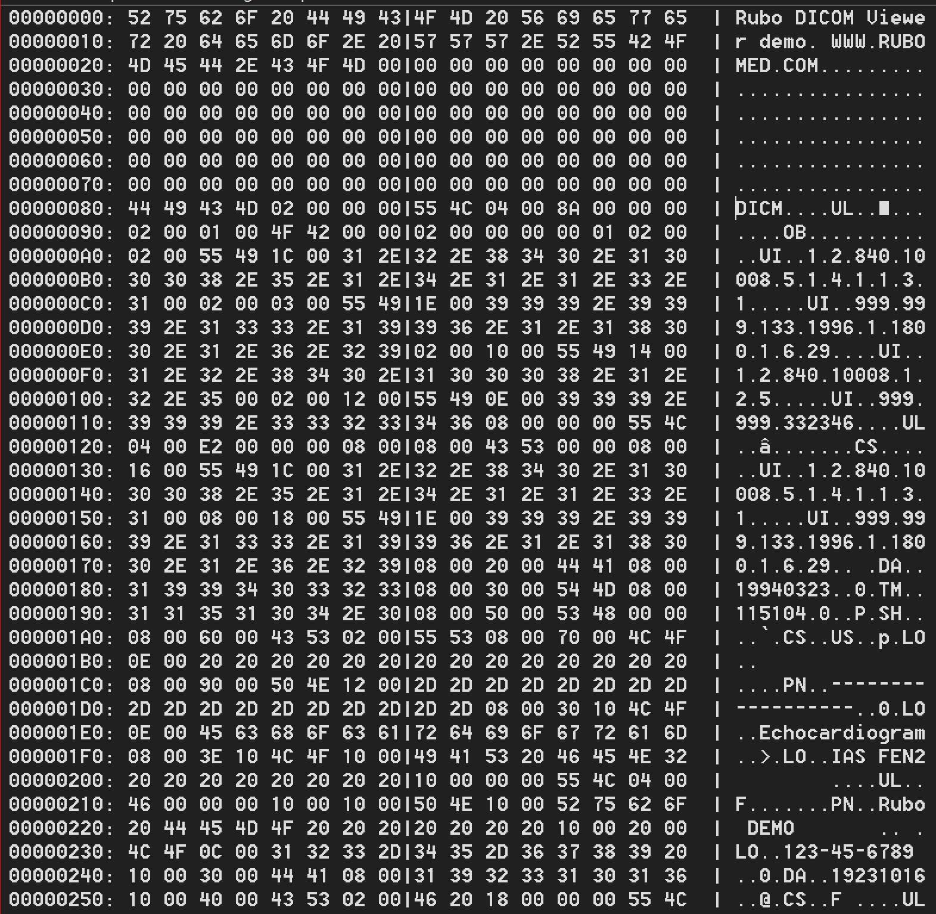
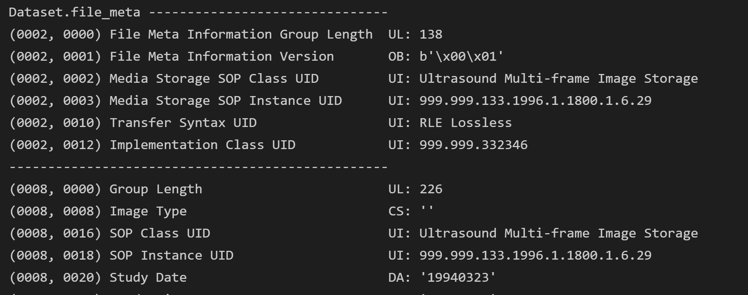
DICOM Media files
Hex representation of the file format

Slide 26
App 2: Dicom objects
You will load a DICOM Object from a file, inspect attributes.

Slide 27
App 3: Pixel Data
You will load a DICOM Object from a file, inspect pixel data, display it using Matplotlib and compute histogram

Slide 28
Transfer syntax

Slide 29
Cornell bug JPEG photometric 1

Slide 31
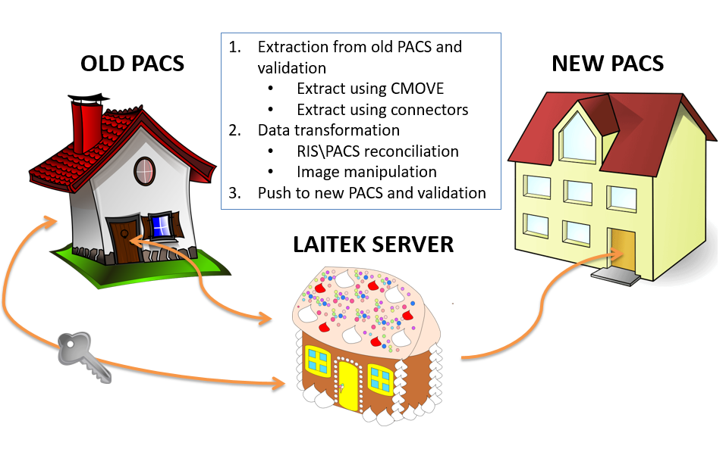
Migration

Slide 32
Protocols
DICOM is used for image transfer;
HL7 is used for other types of information transfer, such as patient information, or orders and reports.

Slide 33
DICOM: Data Format
Series Series Instance UID
e.g., A series without contrast, a series performed 5 minutes after contrast was administered, a series performed 15 minutes after contrast was administered)
Image
SOP Instance UID
Image
Pixel data can be uncompressed (raw) or compressed using various standards (for example, JPEG, JPEG lossless, JPEG 2000). This is specified by the Transfer Syntax.
Image
For example, a chest X-ray image) contains, besides the actual image (called pixel data), other information (called attributes), such as the name of the patient, the ID of the patient, the date on which the image was performed etc→ DICOM Tags
Study Study Instance UID
A collection of images performed as part of an examination (for example, a head CT)
Resources: http://192.168.0.162/mediawiki/index.php/DICOM_standard_and_processes
http://192.168.0.162/mediawiki/index.php/Medical_images_samples_with_various_compression_types#BW_US
Notes:
1980 In the beginning… it was very difficult for anyone other than manufacturers of computed tomography (CT) or magnetic resonance imaging (MRI) devices to decode the images that the machines generated, or to print them.
1983
The American College of Radiology (ACR) and the National Electrical Manufacturers Association (NEMA) joined forces and formed a standards committee to meet the combined needs of radiologists, physicists and equipment vendors.
https://www.dicomstandard.org/history/

Slide 34
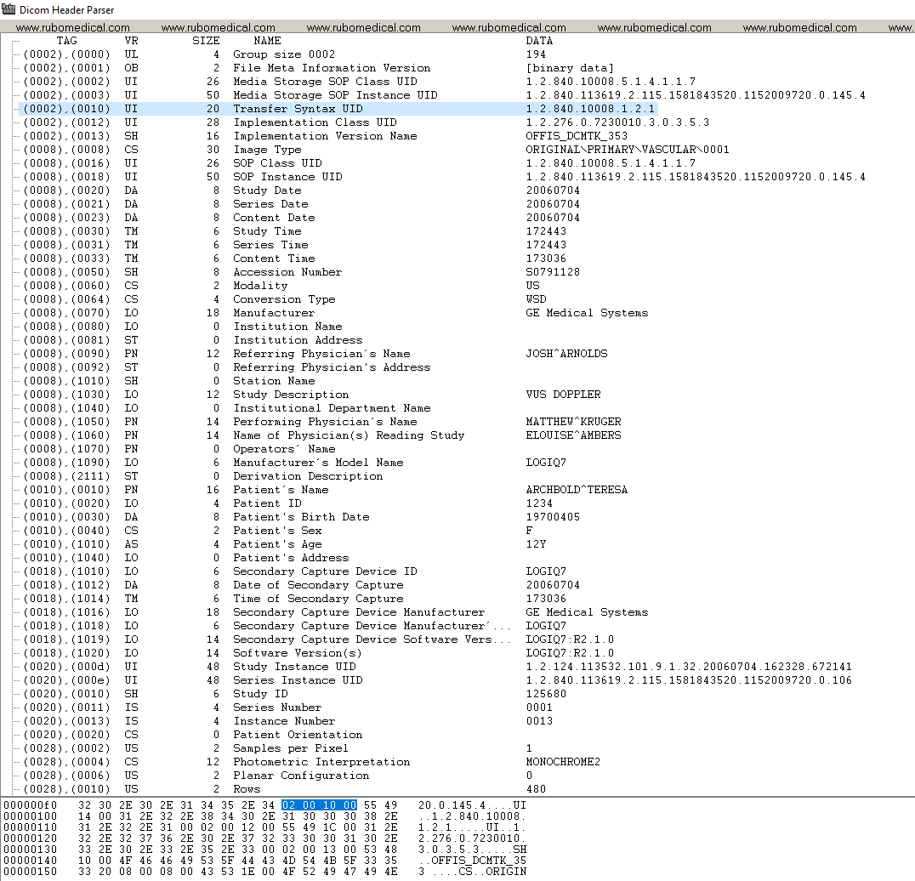
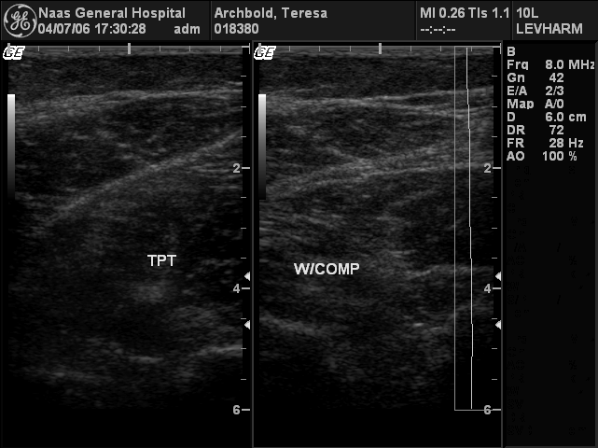
Reading DICOM Information
DICOM has meta information which is composed of a set of tags. Each type of tag represents an element or a piece of information regarding the file, this includes patient information, modality information, study information, and so on.
Efilm and DICOM Header Parser are just two examples of applications that let us view this information and even edit it. See example below:

Slide 35
DICOM: Communication
Application Entity (AE)
Application Entity (AE)
There are different types of communication between application entities. These are specified by the Service Class:
storage service class – for storing data,
query/retrieve service class – for querying for data/retrieving data
Resource http://192.168.0.162/mediawiki/index.php/DICOM_standard_and_processes
Notes:
The systems (processes) that communicate using DICOM are called application entities. An application entity is identified by an AE Title (for example, CT_Room1 or MIGR_QUERYSCU or GEPACS). The application entity uses this AE Title to identify itself to other devices it communicates with.
There are different types of communication between application entities. These are specified by the Service Class: e.g. storage service class – for storing data, query/retrieve service class – for querying for data/retrieving data.
When AEs communicate, they can play two different roles: Service Class User (SCU) and Service Class Provider (SCP).
For example, when AE CT_Room1 sends images to AE GEPACS, these play the following roles:
GEPACS AE is a Storage Service Class Provider (SCP) – it offers the option to store the images;
CT_Room1 AE is a Storage Service Class User (SCU) – it asks the other AE to store the images.
The communication between two AEs is done through associations. An association is a connection established between 2 AEs. In order to be able to communicate, the AEs will negotiate the association: they will determine if they know how to exchange the data. For example, an ultrasound unit would ask the printer if it supports color. If not, then it can decide that black/white is good enough and send the images, or it can decide not to send to this printer and choose a different printer which does support color (depending on how it is setup).

Slide 36







The DICOM Gift C-FIND & C-MOVE to third party
CMOVE
Romania
USA
CFIND
France

Slide 37
The DICOM Gift C-FIND & C-MOVE to self & C-STORE
C-STORE
C-MOVE
Romania
Romania
C-FIND
France

Slide 38
Migration in a nutshell
1.Setup
2.Data cleansing: reconciliation and transformations
3.Extracting from legacy into buffer storage
4.Migrating into the target from the buffer
5.Project close

Slide 39

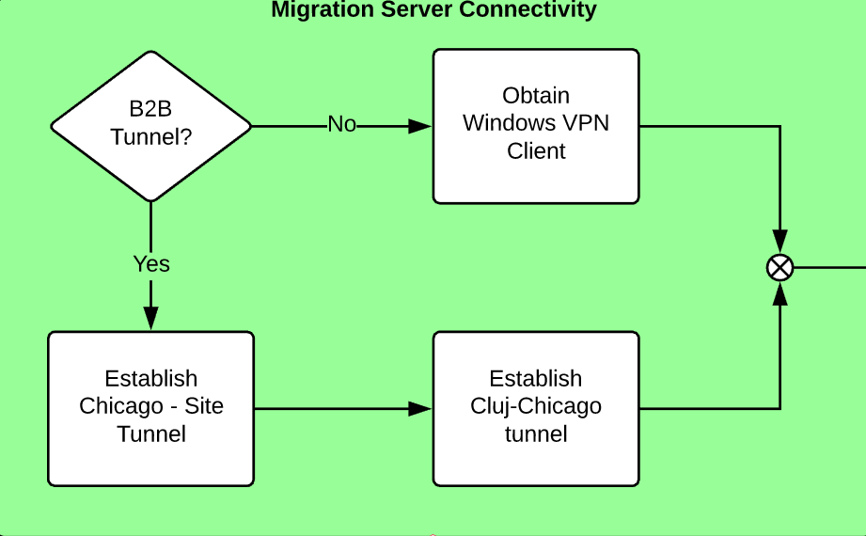
Migration Setup – Server Connectivity

Slide 40
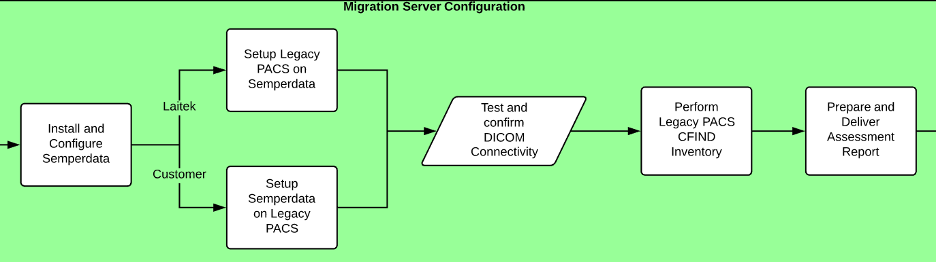
Migration Setup – Server Configuration

Slide 41
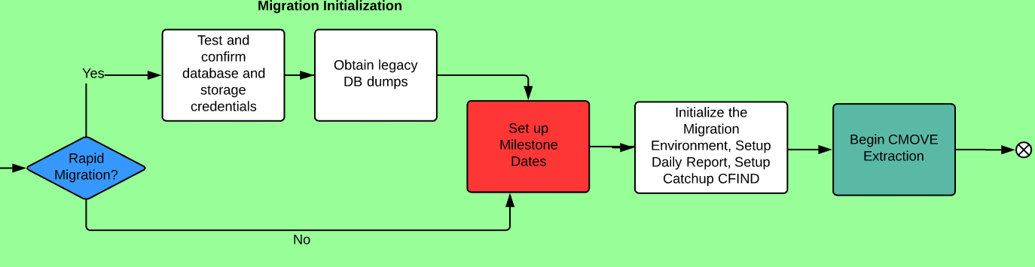
Migration Setup - Initialization

Slide 42
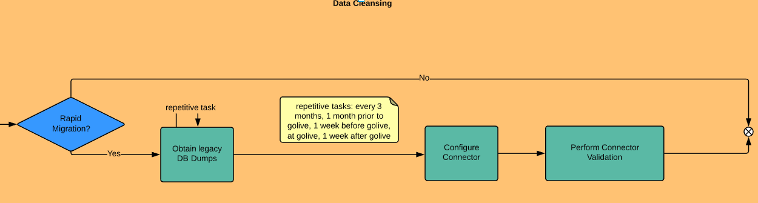
Data Cleansing and Staging

Slide 43
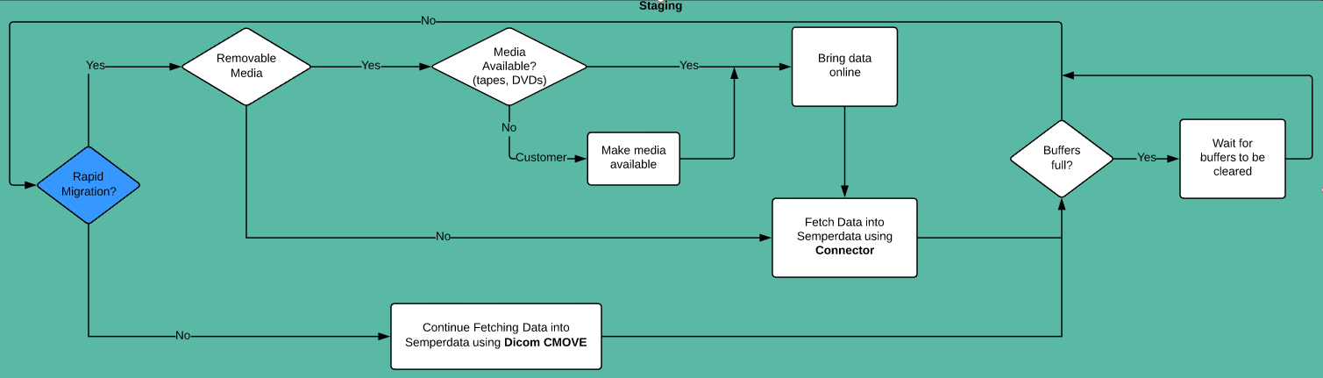
Staging

Slide 44
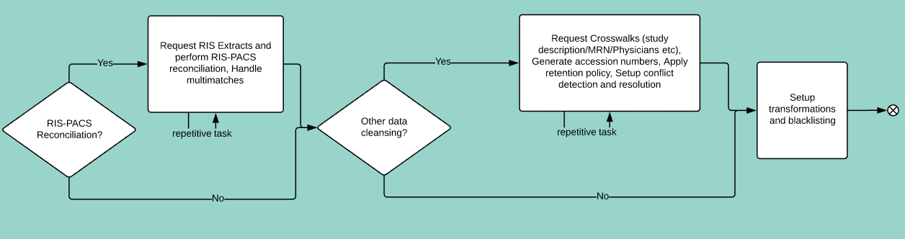
Data cleansing

Slide 45
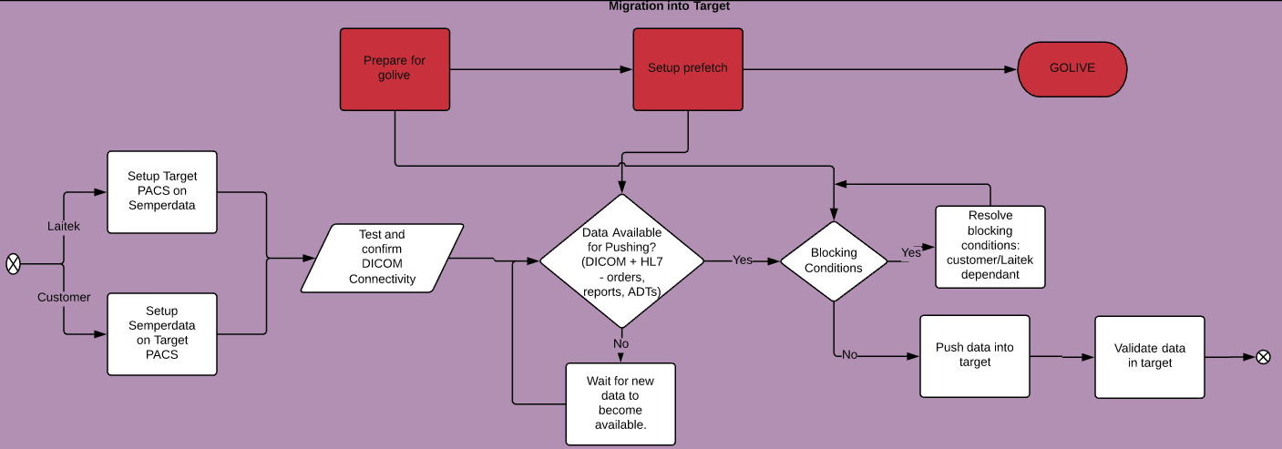
Migration into Target

Slide 46
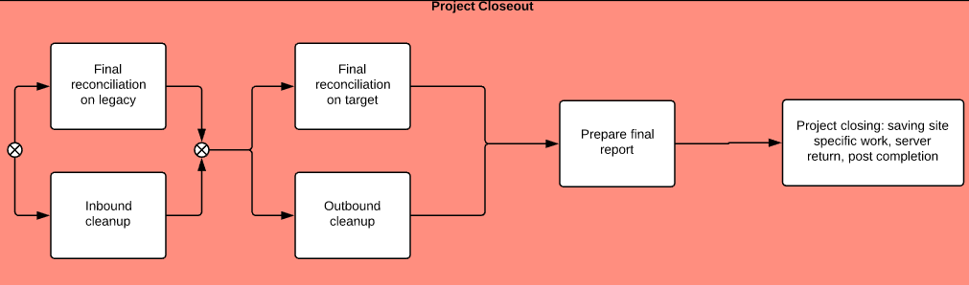
Project Closeout

Slide 47
Thank you!

